Slide 1
ANALYSIS OF VARIANCES
Analysis of variance (ANOVA) is a collection of statistical models and their associated estimation procedures (such as the "variation" among and between groups) used to analyze the differences among group means in a sample

Slide 2
 | Group 1 | Group 2 | Group 3
Sample Size | n1 | n2 | n3
Sample Mean | m1 | m2 | m3
Sample Standar Deviasi | sd1 | sd2 | sd3
H0 : Tidak ada perbedaan antara group
H1 : Ada perbedaan diantara group Ho diterima jika P-value lebih dari 0.05
H1 diterima jika P-value kurang dari 0.05

Slide 3
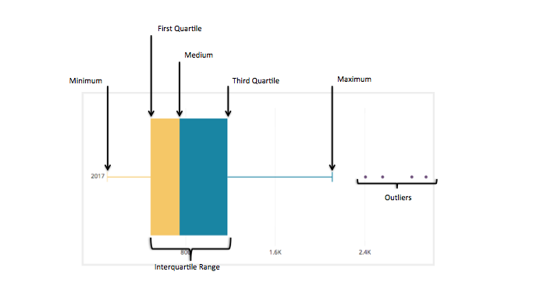
Graphics : Box Plot
A Box Plot is the visual representation of the statistical five number summary of a given data set. A Five Number Summary includes: minimum, first quartile, median (second quartile), third quartile, maximum and outliers

Slide 4
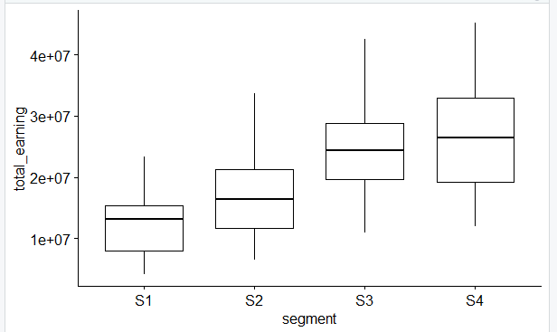
Visualize The Data
library("ggpubr")
ggboxplot(Data_Driver, x = "segment", y = "total_earning", order = c("S1", "S2", "S3", "S4"), ylab = "total_earning", xlab = "segment")

Slide 5
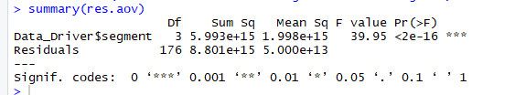
Compute one-way ANOVA test
library(dplyr)
# Compute the analysis of variance res.aov resaov=aov(Data_driver$total_earning~Data_driver$Segment) # Summary of the analysis summary(res.aov)

Slide 6
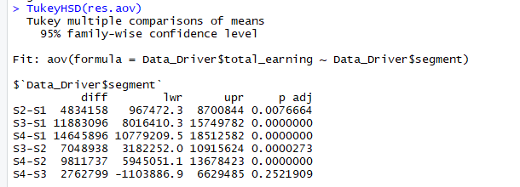
Tukey multiple pairwise-comparisons
TukeyHSD(res.aov)

